Slide 1
R&S IM Spacing Sweep User Guide
Nick Lalic
VNA Software Developer
Rohde & Schwarz North America
September 2nd, 2016

Slide 2
Typical Setup
External coupler combined input tones
Actual setup may vary with measurement needs
Port1
Port3
Port2
S1
a1
S3
a3
b2
Lower input tone
Upper input tone
DUT

Slide 3
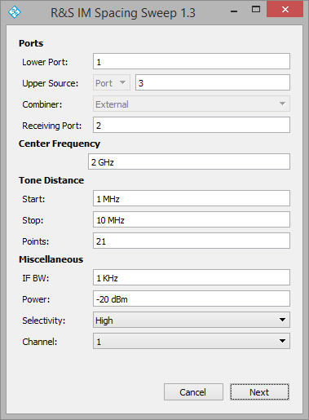
Settings
Start tone distance
f_{lower}
f_{center}
f_{upper}
Stop tone distance

Slide 4
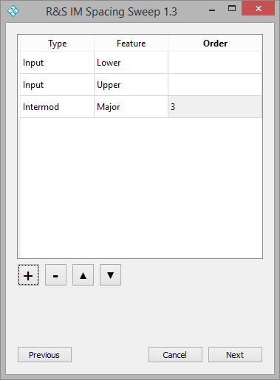
Traces
Type:
Input
Output
Intermod
Relative (normalized)
Intercept
Feature:
Lower
Upper
Major (maximum)
Order:
3, 5, 7 or 9th order harmonics

Slide 5
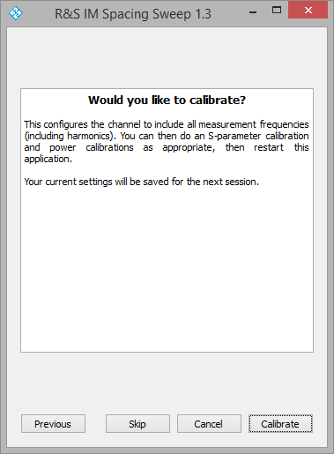
Calibration
Calibration step (optional)
Creates segmented sweep in channel with all frequencies
Application exits
Perform three power cals:
Lower source
Upper source
Receiver

Slide 6
Typical Calibration
Step 1
Perform power calibration of lower input source and reference receiver at DUT input plane
Port1
Port3
Port2
S1
a1
S3
a3
b2
Lower input tone
Upper input tone
Attach power sensor

Slide 7
Typical Calibration
Step 2
Perform power calibration of upper input source and reference receiver at DUT input plane
Port1
Port3
Port2
S1
a1
S3
a3
b2
Lower input tone
Upper input tone
Attach power sensor

Slide 8
Typical Calibration
Step 3
Use one of the calibrated sources to perform a power calibration on the receiver
Note: There will be some imbedded loss from the thru connector used to bypass the DUT. An alternative is to calibrate the source on the unused port with the connector attached, then calibrate the receiver
Port1
Port3
Port2
S1
a1
S3
a3
b2
Lower input tone
Upper input tone

Slide 9
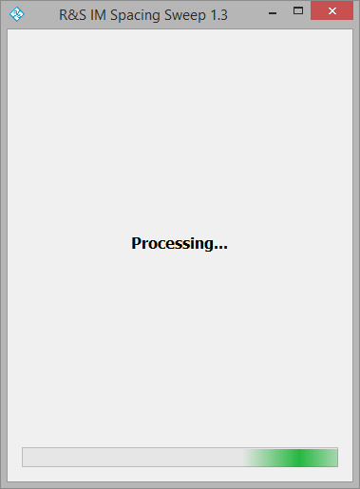
Apply traces
Restart application
Confirm settings
Skip calibration (already done)
VNA is configured for measurement

Slide 10
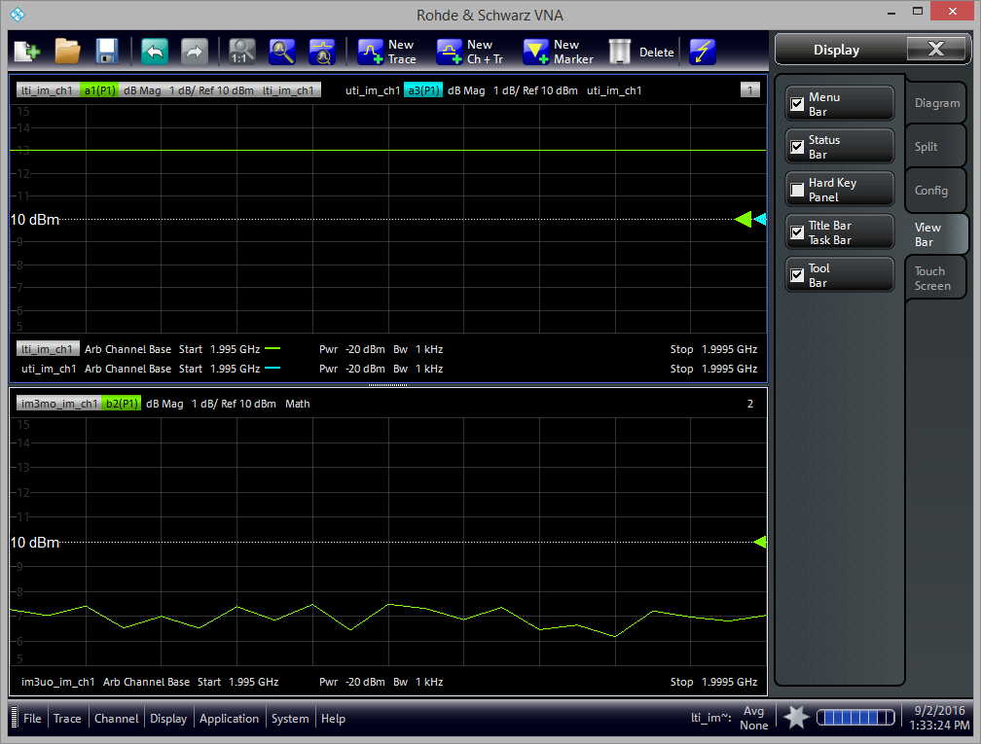
Configure Display
Traces are created in new display window
Rearrange traces as necessary
Do not rename or delete: trace math depends on other traces

Slide 11
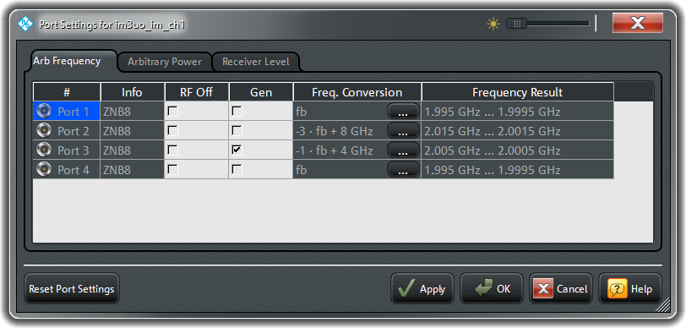
Under the hood
The application uses the arbitrary frequency port settings to achieve measurements across tone distance
Here’s an example screenshot for the upper 3rd order intermod product with the following settings:
Port 1 lower input tone
Port 3 upper input tone
Port 2 receiver (output)
2 GHz center frequency
1 MHz start tone spacing
10 MHz stop tone spacing

Slide 12
Contact
Please contact me with questions or comments
Nick Lalic VNA Software Developer
San Francisco, CA
+1 (424) 200-2846 nick.lalic@rsa.rohde-schwarz.com
http://vna.rs-us.net

